Slide 1


Project Stakeholders Presentation:
COST SAVING
Target Stakeholder Group: Senior leaders

Slide 2
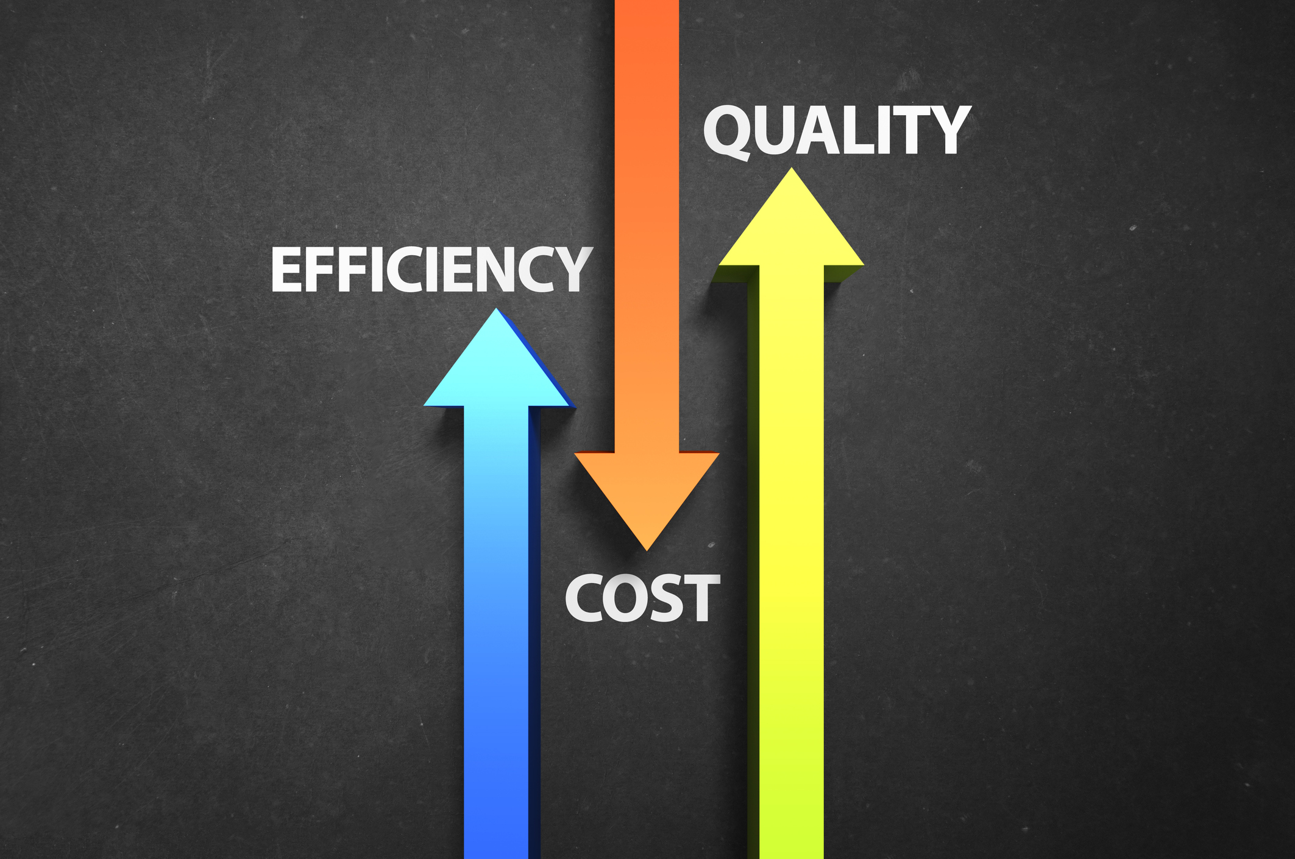
The aim is to increase the speed of the project at a lower cost.
**This presentation is based on a few cases and assumptions, included in the upcoming slides.

Slide 3
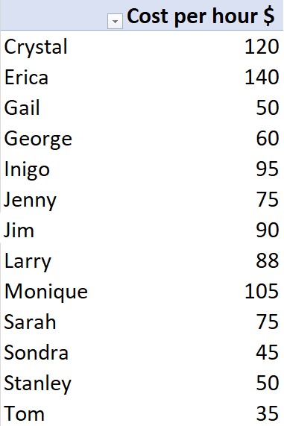
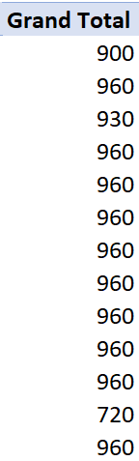
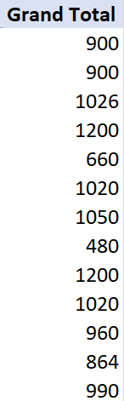
Comparison of the Cost/hr, Budgeted hours, and Actual Hours of all resources
Observations:
Erica, Inigo, and Larry completed the task in less than the expected time.
Crystal and Monique are one of the costliest resources.
Also, Jim and Monique have taken more than the expected time, thus adding to the projects’ overall cost.
Inference:
Redistribution of the work is required.
Resources taking a lesser amount of time and costing lesser should be assigned more tasks than the slower and costlier ones.
This will benefit the project in both ways: speed and costs.

Slide 4
Amount Saved
Case: If Jim and Monique are replaced by other resources similar to Inigo and Larry.
(These 4 can be compared because they were allotted same budget hours)
{94500(Crystal) + 126000(Monique)} – {42240(Larry) + 62700(Inigo)}
= $ 129,060
The total cost of the projects combined = $ 956,790
Thus, we can cut down the costs by 13.49%.

Slide 5
Summary
Given that we are able to replace a couple of resources with more efficient ones, we can deliver the project in lesser time and at lesser costs.
Thank You

